Slide 1
Invisibility can kill you
Alejandro Urueña calderón
9B

Slide 2
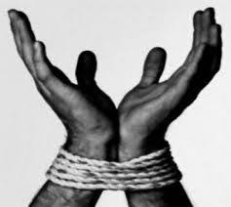
IMPOTENCE
Impotence is the emotion that occurs in those situations in which we want to achieve something and we see that we do not achieve it. Lack of strength, power, or competence to do a thing, make it happen, or resist it.
- This is the concept that I will work in this proposal.

Slide 3
Selected Object and Story
Story: This is the bell that my grandmother used when she needed something when she was sick. In 2013, in June or July (I don’t remember that well because I was little), the doctors had discovered a very big and developed tumor on her brain. The whole family was devastated and were very worried. She still looked fine and although she was worried, her happiness never disappeared. In the final months of 2013, she took a date for a job in a textile company that would help the economy of the family. But without knowing it, she met with a person that carried a disease(I forgot its name), which made the digestive organs malfunction and collapse. After that meeting, she started to look very ill and weak. But the doctors had said that it seemed that she was going to be able to cure from that tumor, but the bacteria that this man transmitted to her lowered the possibility a lot. After lots of immunotherapy's, surgeries and other procedures, they told us that this bacteria had affected her body a lot, so that they weren’t able to cure her. It had been a whole year, for nothing. Finally, my grandmother died in 2015 from that disease, and for me, it was like loosing my greatest inspiration and an example of life, because that’s what she meant for me.

Slide 4
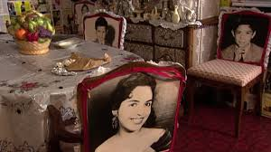
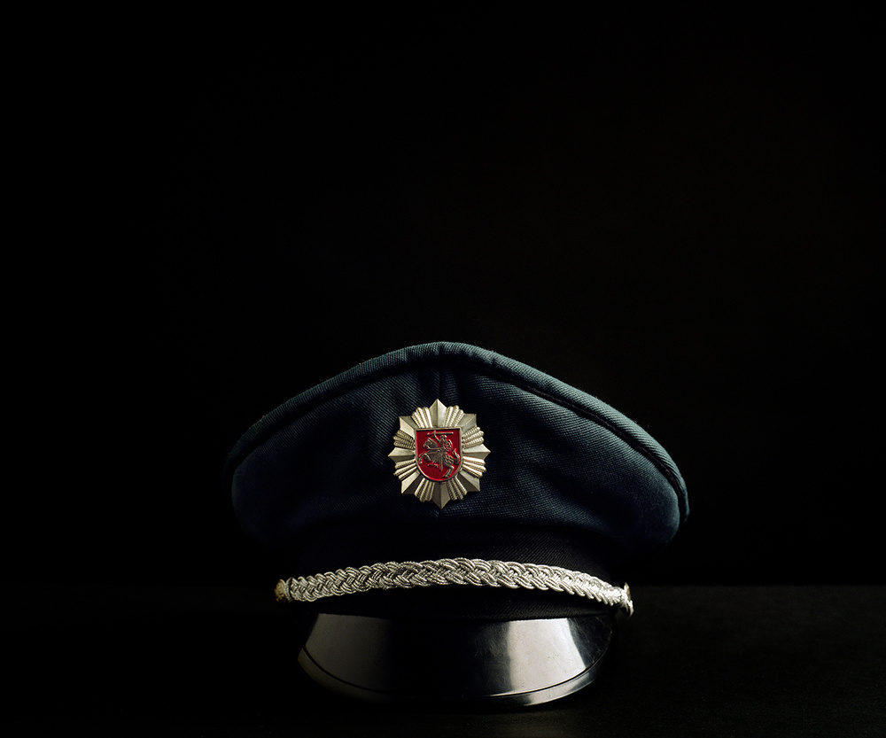
Referential Analysis
For this work, I am going to take as references these two following artists;
Pepón Osorio
Artwork: "Art in the Twenty-First Century”(2001)
“Pepón Osorio’s work is heavily influenced by his experience as a social worker in The Bronx, and his pieces usually evolve from an interaction with the neighborhoods and people among which he is working.”
Indre Šervytyté
Artwork: “A State of Silence” (2006)
“The Lithuanian papers wrote that it was a “painful misfortune (a catastrophe). She pays tribute to the artist's father, Albinas Šerpytis, Lithuania's Head of Government Security, who died in suspicious circumstances in a car accident in the early hours of October 13, 2001.”
Pepon Osorio
Indre Šervytyté

Slide 5
Pepón Osorio
Aesthetic characteristics; This artist uses different elements to describe the pain and suffering in which he finds himself on his artworks, by for example the knives that are stuck to the couch. Another aesthetic characteristic of Osorio is the use of old photography's of the people that are missing, which they place in an specific chair, as if they were placed there. He doesn’t uses that much paint or materials of that kind, he uses more objects like belongings of one person, family photos and portraits of the person he is showing on his art piece.
Conceptual characteristics; The concept that Pepon Osorio is working on his performances is the pain and the absence of someone, which is my reference for my work, taking into account that I am working with the absence in my project, and I will show through that representation of Osorio’s “family table” the absence of the character I will mostly talk about, that is my grandmother.

Slide 6
Indre Šervytyté
Aesthetic characteristics; Indre Šervytyté makes a very interesting art piece, in which she uses elements that represent the moments in which his father was mysteriously assassinated. For this art pieces, she selects a dark background and positions certain objects so that through the photography, she can take some photos. She only takes photos of important or significant objects that referred to his father or had an emotional symbology to her, like the military hat in one of his photos or even the Russian passport.
Conceptual characteristics; The artist with this photos works a lot with the concept of absence, when she expresses his pain and sadness of his father that is gone through the photos and elements thar represents him, which is exactly what I am going to do; to select inherited items or items that meant a lot to my grandmother sot that I can highlight the level of absence that it produces in me, and more especially in the majority of my family.

Slide 7
Explained Sketch
I will be using an empty room of my house to develop this project. I am going to use 7 pictures of my grandmother and they will be suspended in the air, hanging in a thread rope. My sister, she has this little hair clips of flowers, which I will be using to represent the virus, and also to show how the disease spreads in every photo, representing her disease and the time it can take a virus to “eat up” a person. First, I will start with few clips around the edge of the photo. Then, adding more and more with every picture, so that in the seventh picture is full with the hair clips, representing that the virus has totally spread and unfortunately kill the person. Apart from that, this hair clips will be green, so that there are more alike to the common shapes and colors of viruses.
For my other part of my work, I will be using four pedestals, in which I will present the different objects that not only in the present but in the future, will remember us of this pandemic in which we are and the things that we needed to do to be safe. The four objects will be: Some bottles of alcohol, quaternary ammonium, a substance to clean small vehicles and clothes and don’t damage it, some big bottles of antibacterial gel for the hands and finally some faces masks. With this, I will try to show the important elements that we can use to take care of ourselves and others. In order to talk about the social distancing, with a red tape in the ground, I will make some lines that will be between some of the pedestals pointing that they need to be 2 meters apart from them , just as we need to do on the streets. Finally, in order to “close” the project or “quarantine” it, I will put a big yellow tape that reads; “BIOHAZARD TERRITORY DO NOT CROSS THE LINE”, so that the audience cannot pass and only watch it in the distance.

Slide 8
Curatorial Sketch

Slide 9
Reference Card
Title: Invisibility can kill you
Author: Alejandro Urueña
Impotence. There are things that we can’t control. The actual situation in which we are right now, fighting an invisible, mortal virus(COVID-19), makes us more conscious of the health and security of your family and beloved ones. Have you ever imagined any close relative getting extremely ill by some deadly virus or a rare disease? Worst of all, have you ever imagined not being able to do something about it, and just watch them fade away, as your memories and emotions about them drain because of the fear of losing them? Well, with this art piece, I wanted to show that, and the fact that now, more than ever, we need to be more careful about the situation we find ourselves in. So, judge for yourself and see how you can look after your family to keep them save. In the end, they are only thing you will never lose.

Slide 10
Body and Space
I am going to do a an installation, in which the public can be wrapped in the environment that my art piece is trying to convey. It will not be a performance, and I will exhibit it through video and photographing as a second option for the presentation of my work.

Slide 11
Thank you!

